Slide 1

Welcome to our E-commerce website

Slide 2
SHOP
“Don’t stress about the dress,
we’ll dress you to impress.”

Slide 3

Team members :
Prakash Shah(205028)
Sagar Goswami(205040)
Sonali Rawat(205049)
Teesha Singhal(205041)

Slide 4

What is E-commerce ?
Also known as electronic commerce or internet commerce, refers to the buying and selling of goods or services using the internet.
Basically, it is nothing more than buying something online.

Slide 5
Aim
This project aims to make a Dummy website for demonstration of technology learned by students of BCA Semester 5.
This is a dummy E-Shopping website which aim to show how basic technologies of web development can be used to create an eye soothing website that is also user-friendly.

Slide 6
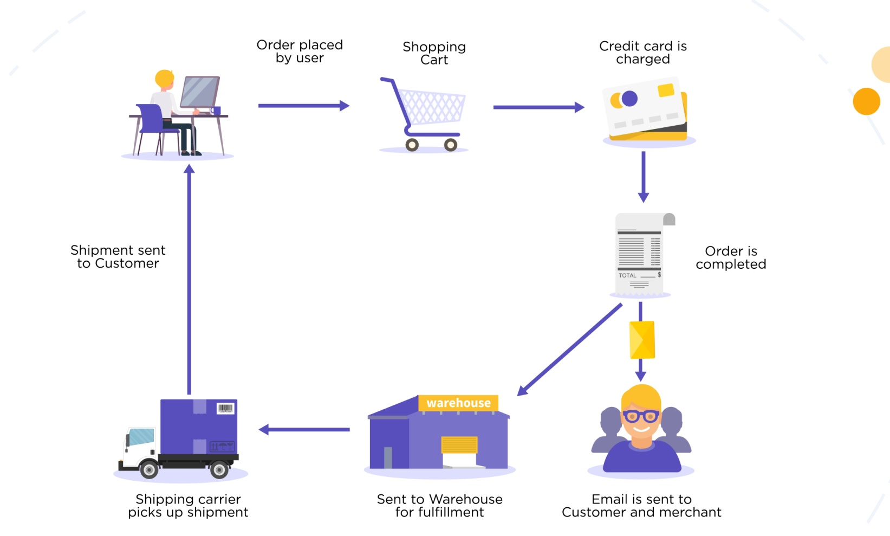
Process of E-commerce

Slide 7

Modules
Menu
Shopping cart
Category browsing
About site
About us
FAQ
Blog
Registration
Sign-in
Dynamic darkmode

Slide 8


Tools and Database
Languages
HTML5
CSS3
Javascript
PHP 8.1
Visual Studio Code
Apache Server
SQLite Database
Git

Slide 9
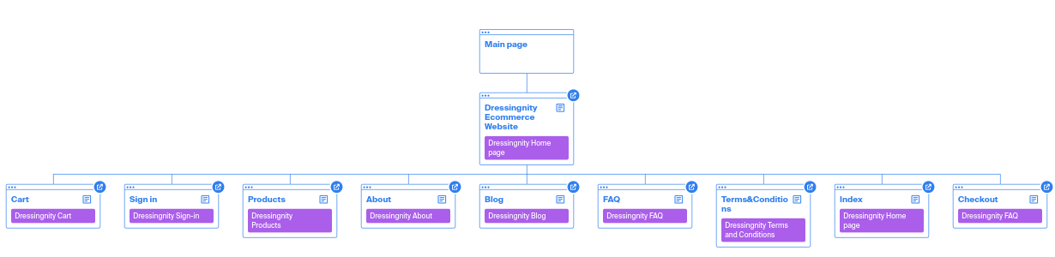
Website Structure Diagram

Slide 10
Features
User can “Register” to website using their Credentials.
User can “Login” through credential used for registration.
Website saves “Cookies” to retain sessions for specific computers.
Website is secured with SSL certificate and HTTPS protocol.
Website is hosted on both the custom domain(Dressingnity) as well as GitHub Pages.
User can directly contact us through custom Email: dressingnity@altmails.com.
Dedicated Day and Night mode available for Ease of use.
Custom Error 404 page for UI Friendliness.
Fully Open-soured and uses Apache2.0 license

Slide 11
Limitations
1. The functionality of cart is not working yet.
2. Payment gateway is not implemented.
3. API for Products info is not integrated

Slide 12
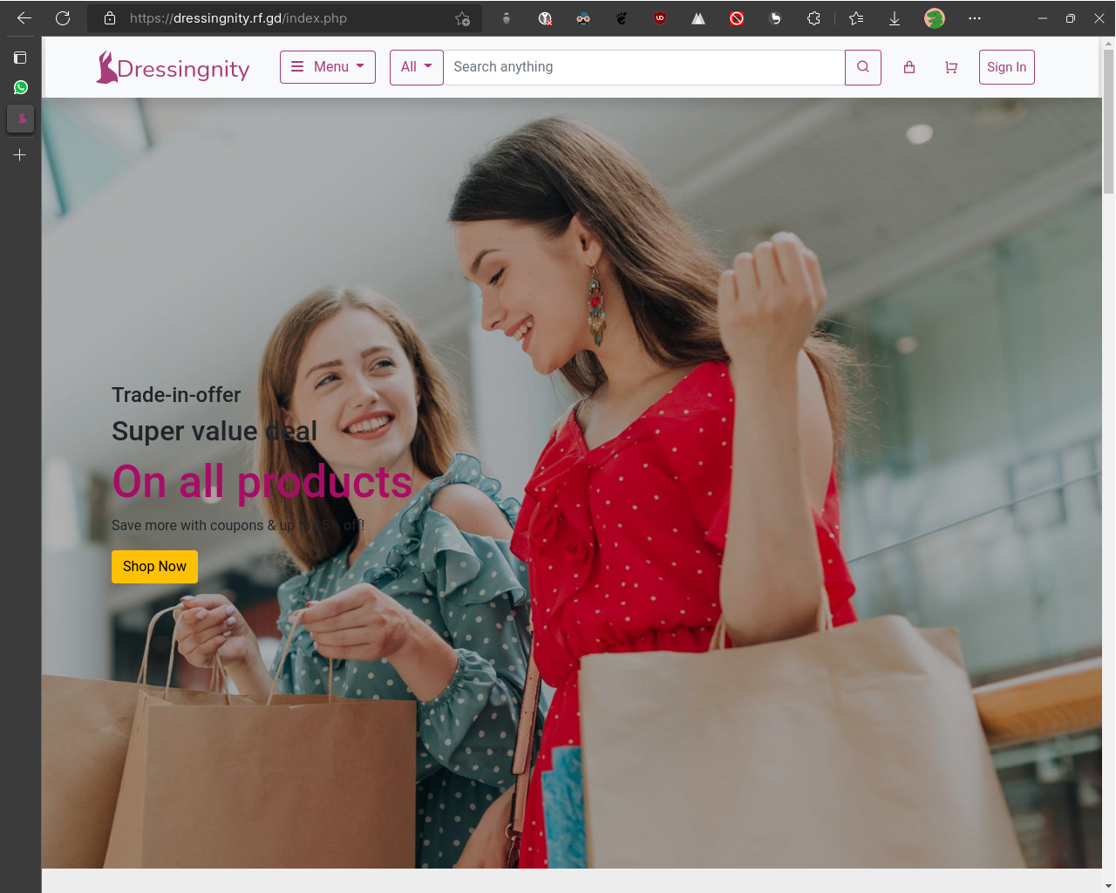
Homepage

Slide 13
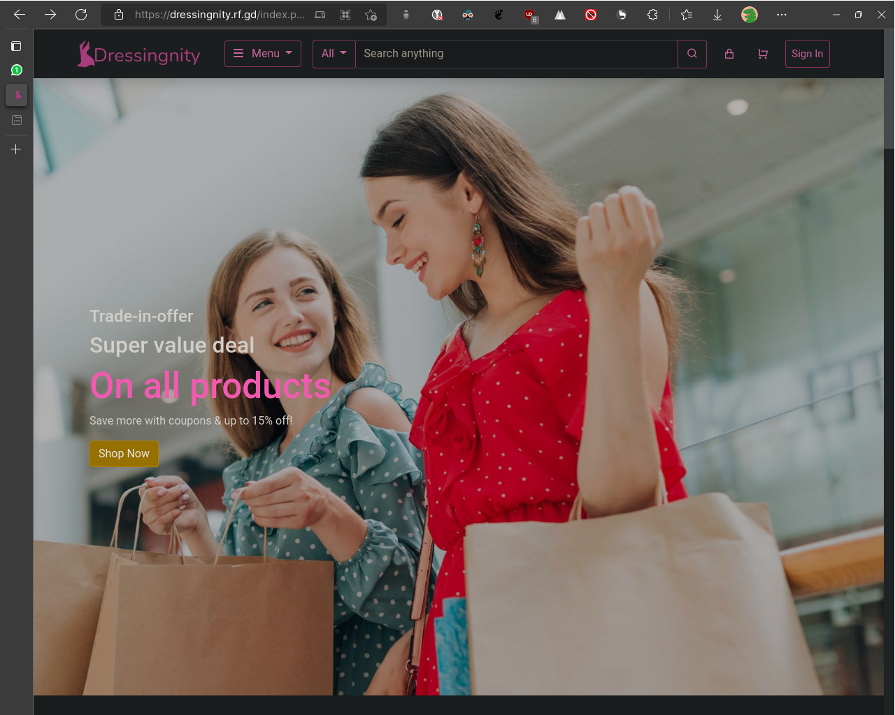
Homepage - Darkmode

Slide 14
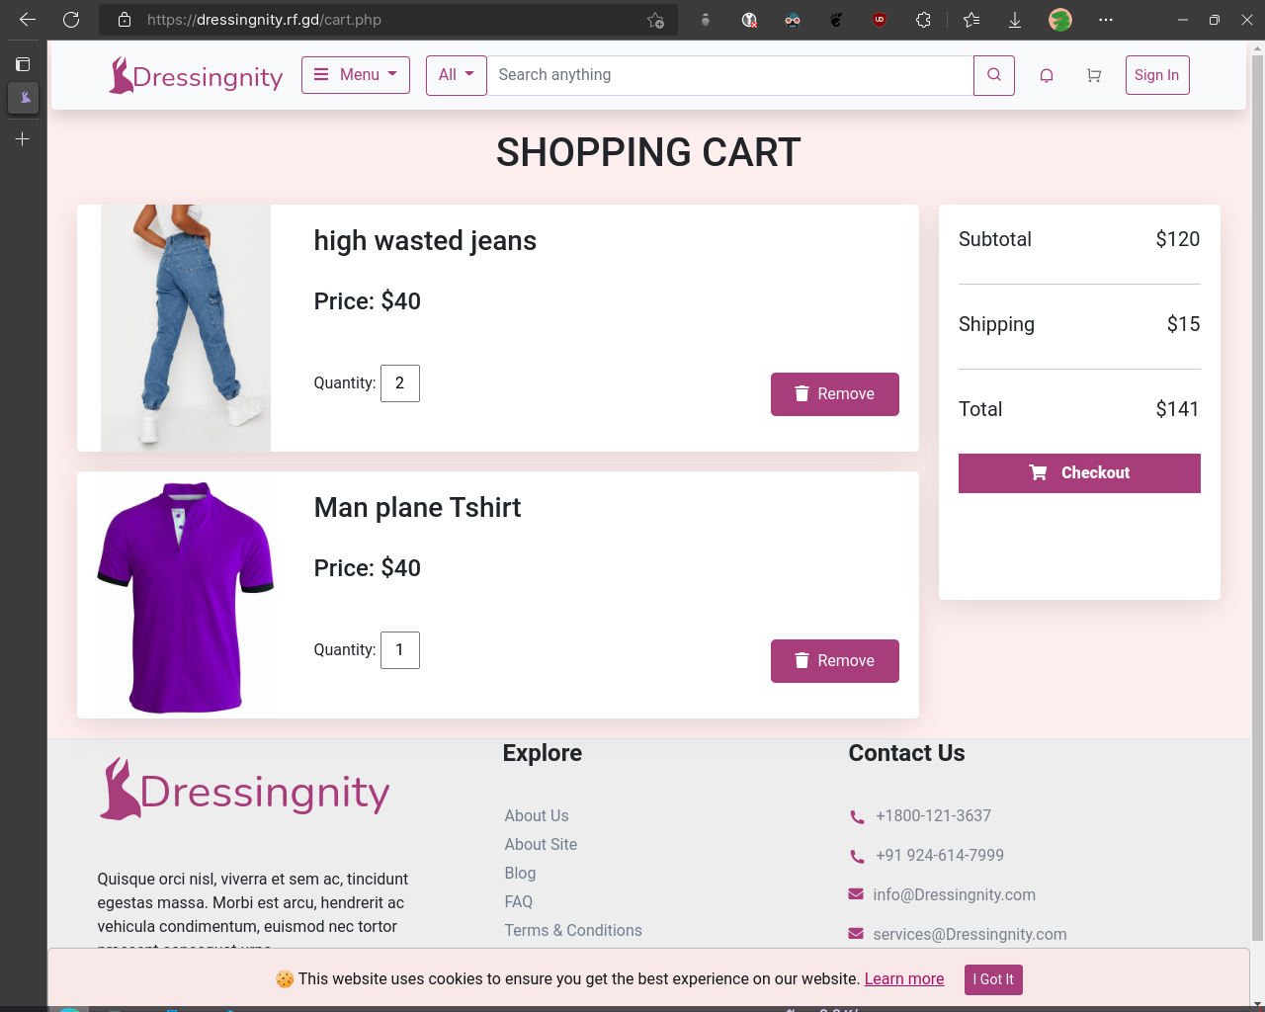
Cart Page

Slide 15
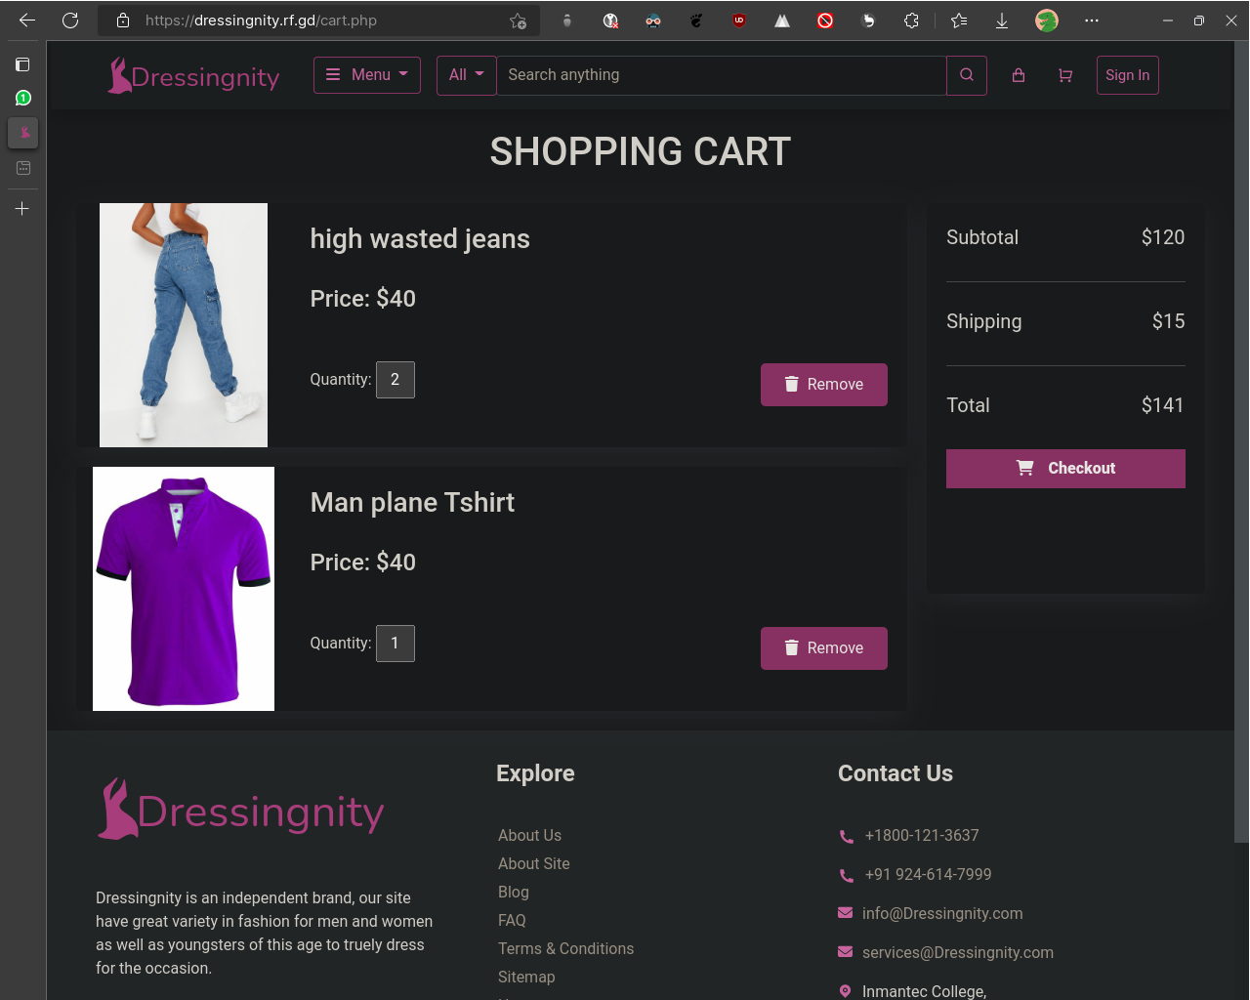
Cart Page - Darkmode

Slide 16
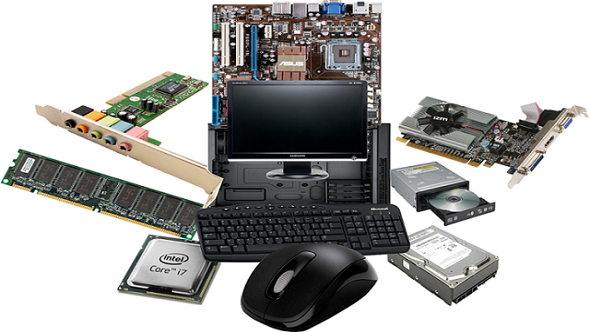
Hardware requirements
1.5 GHz processor or higher.
4 GB RAM or higher.
4 GB Available Hard Drive Space(for Browser).
Windows 7 SP2 or later operating system OR Any LINUX distribution or MAC OS.
An active Internet Connection.

Slide 17

Software requirements
Any Modern OS.
Visual Studio Code.
Git and GitHub.
Modern Web browser (Microsoft Edge, Google Chrome etc.).
Pesticide Extension.
Edge Developer tools

Slide 18
References
Technology References:
HTML (For Website Structure)
CSS (For Designing and Styling)
JavaScript (For minor Functionality)
Bootstrap (HTML, CSS and JS Framework)
PHP (Backend Database Connectivity)
SQLite (Relational Database)
jQuery (Part of Bootstrap CDN)
LibreOffice (For making this Presentation)
Documentation References:
Mozilla Developers Network
Bootstrap Docs
Others:
Zorin OS 16.2 Pro (Took UI inspiration)
GitHub (Hosting of project files as well as web hosting)
Arch Linux Methodology (KISS Methodology)
Infinity Free Hosting (Hosting)
Composite reference:
Google

Slide 19

Any Question ?

Slide 20


